Slide 1

DAYANANDA SAGAR COLLEGE OF ENGINEERING,
SHAVIGE MALLESHWARA HILLS, K.S. LAYOUT, BANGALORE -560078.
DEPARTMENT OF COMPUTER SCIENCE AND ENGINEERING
IMPLEMENTATION AND CONVERSION OF MULTI-MEDIA FILES THROUGH COMPUTER VISION USING UI/UX
BY
Jennifer S Jeeyar 1DS18CS053
K R Rohit Srivatsa 1DS18CS054
Kanishka Shah 1DS18CS055
Karthik Wadeyar 1DS18CS056

Slide 2
INTRODUCTION
This project is based on implementation of various functions using python libraries which perform specific task. Each function has its own task. These functions convert multimedia files from one form to another and all the functions combined together form a multimedia application. The user can use this or interact with this multimedia application through an interface called graphical user interface (GUI). The project is implemented using python as the programming language with the basic knowledge of computer vision. The various functions included are :
Audio To Text
Text To Speech
PDF Merger
Image To Text

Slide 3
GUI - Graphical User Interface
A GUI (graphical user interface) is a system of interactive visual components for computer software. A GUI displays objects that convey information, and represent actions that can be taken by the user. The objects change color, size, or visibility when the user interacts with them.
Graphical User Interface is preferred more compared to command line interface , because GUI are user friendly and easy to understand.
The GUI is developed using tkinter framework.
Tkinter is a cross-platform framework, therefore the same code can be used on windows, macOS and linux.

Slide 4
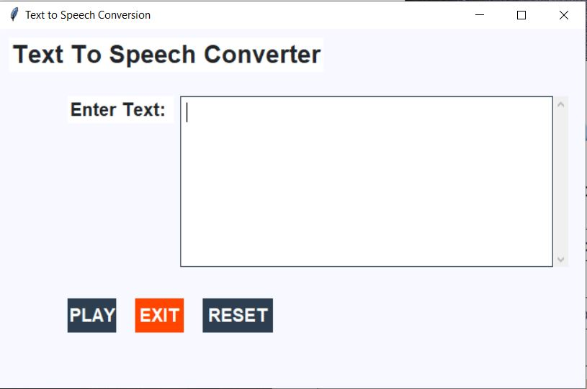
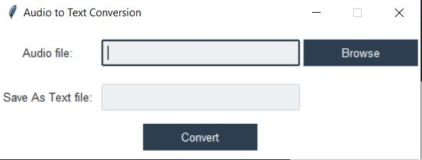
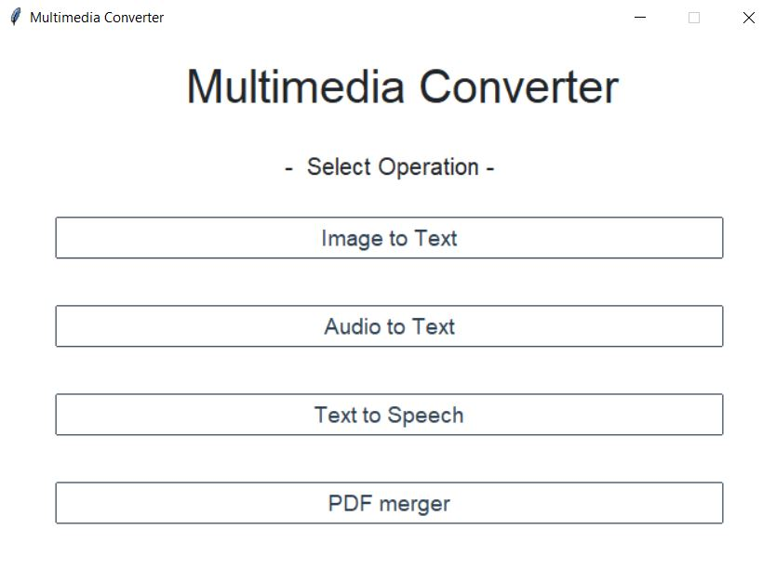
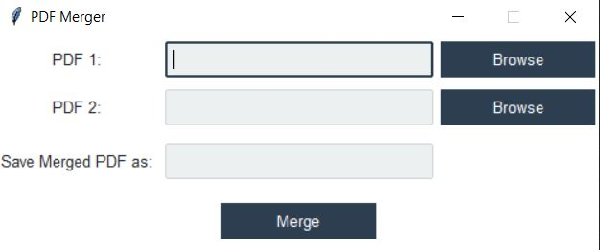
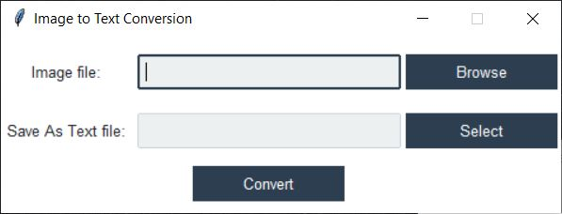
SCREENSHOTS OF GUI

Slide 5
FUNCTIONS
1. Audio To Text :
This function converts a audio file or a speech to text file in a form of a text document.
Python provides an API called SpeechRecognition which allows to convert the audio file to text text file.
2. Text To Speech :
It is a functions which converts text document into audio file or a speech

Slide 6
3. PDF Merger :
One or more PDF files are converted into one PDF file by this function. This helps in arrangement of files and also easier to search and delete the file.
4. Image To Text :
Image To Text function is useful in converting a image that contains text into a text document . This reduces the complexity .

Slide 7
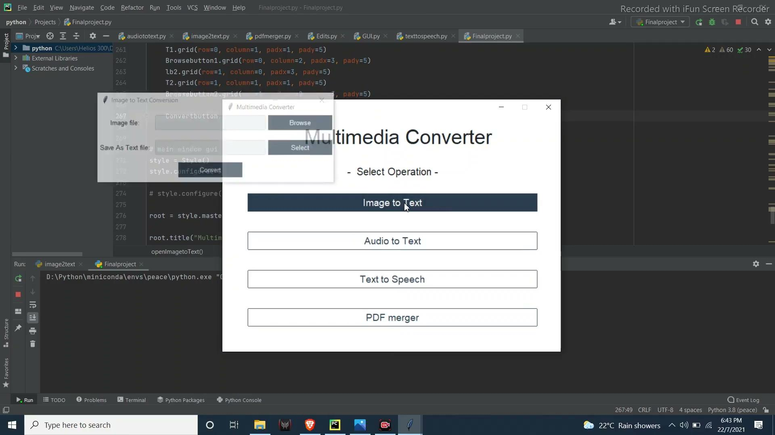
IMAGE TO TEXT

Slide 8
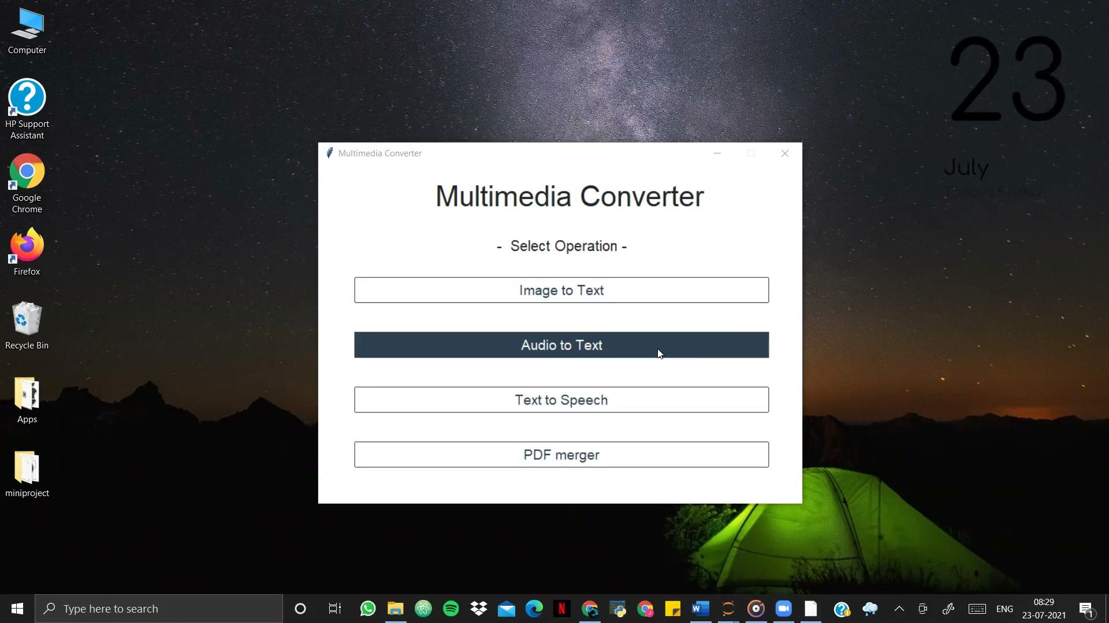
AUDIO TO TEXT

Slide 9
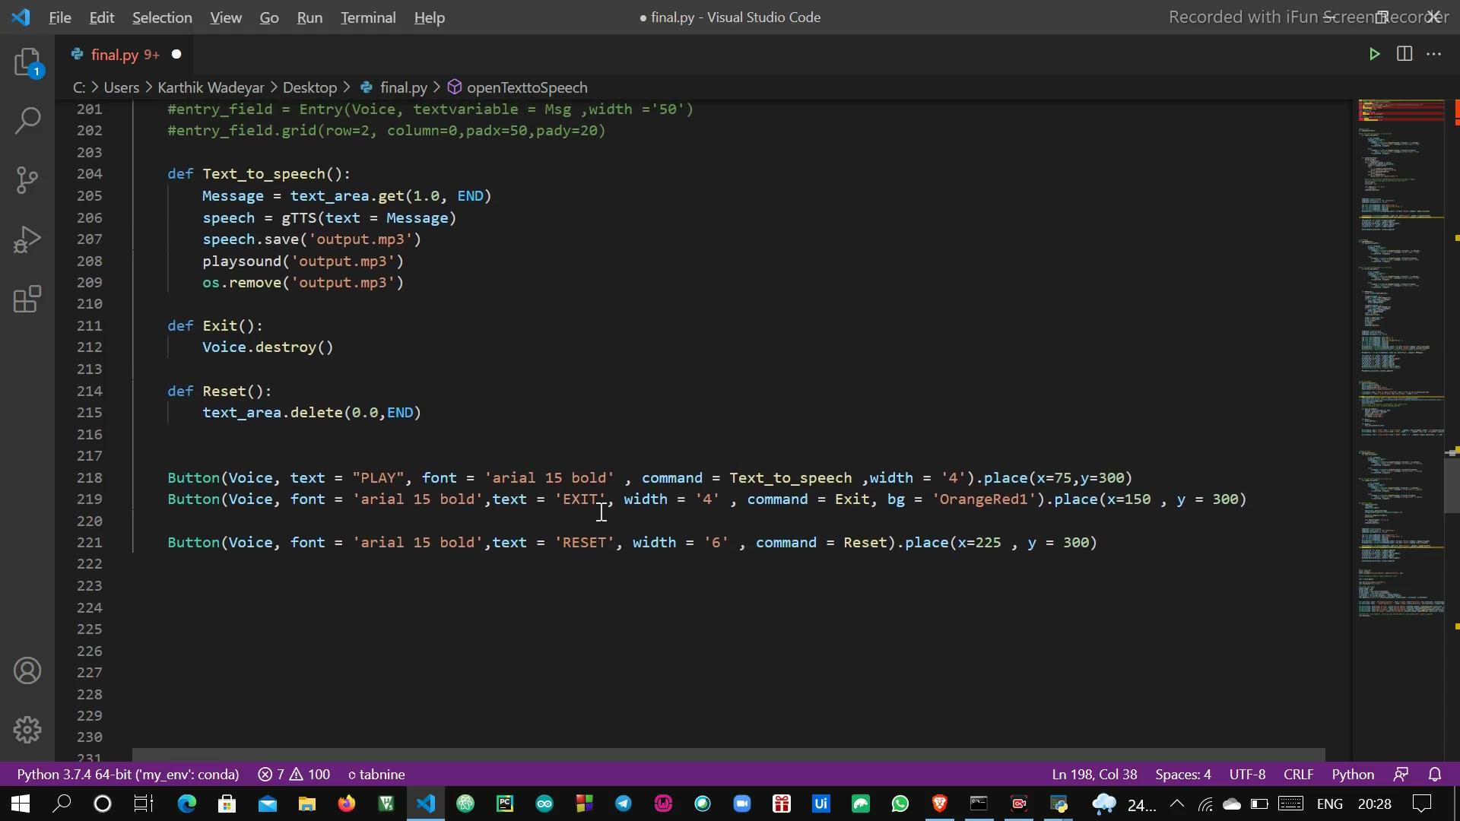
TEXT TO SPEECH

Slide 10
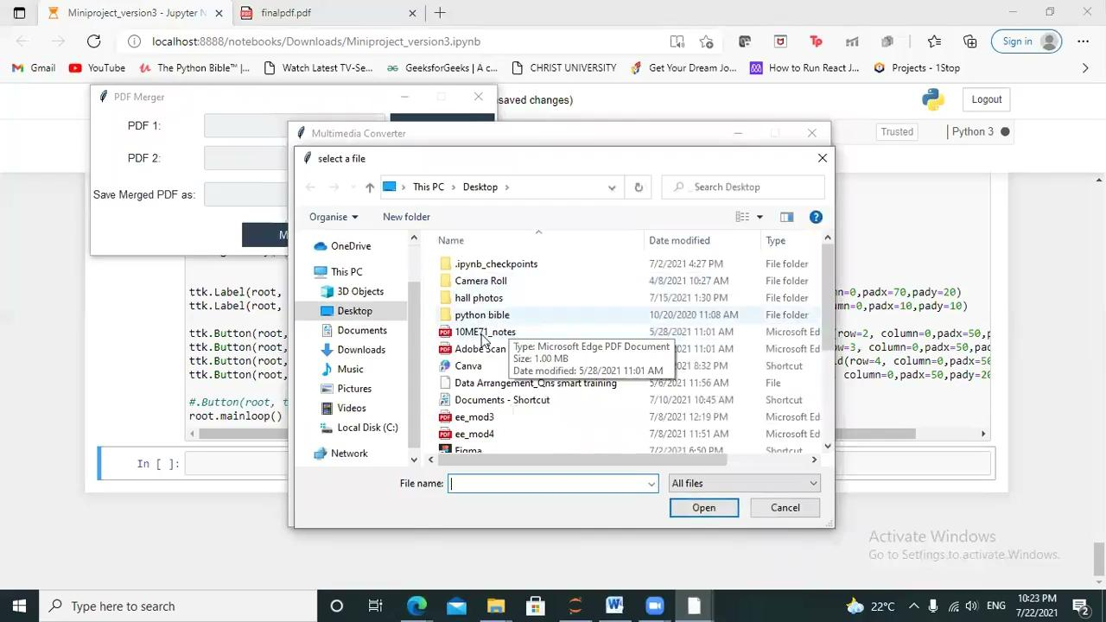
PDF MERGER

Slide 11
Why are these functions required?
These functions have been implemented based on current situations.
Firstly it reduces the manual load of work, it also reduces the mistakes that can take place when it is manually done, it increases the speed of the work , in less time more amount of work can be done.
Secondly, it is implemented with GUI , so that it can used in any device and any configurations. The GUI implemented is user friendly, simple to understand and it is portable .

Slide 12
FUTURE ENHANCEMENTS
This project has a very vast scope in future.
The world of computers fields is not static , it is always subject to be dynamic.
With growing technologies, increasing demands for the product , the purpose of the usage of the product , to meet the necessities of the user , it can further be modified .
This project can be implemented further by adding more functions and features as and when it is required.
We can include functions such as to convert a image in jpeg format to GIF format, function to represent data or important data in form of digital representation or graphical representations

